Slide 1
MapReduce

Slide 2
Mapreduce is a programming model for writing applications that can process big data in parallel on multiple nodes. Mapreduce provides analytical capabilities for analyzing huge volumes of complex data.
Introduction

Slide 3
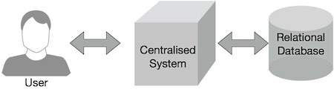
Why MapReduce?
Traditional enterprise systems normally have a centralized server to store and process data.
The following illustration depicts a schematic view of a traditional enterprise system.
Traditional model is certainly not suitable to process huge volumes of scalable data and cannot be accommodated by standard database servers.
Moreover, the centralized system creates too much of a bottleneck while processing multiple files simultaneously.

Slide 4
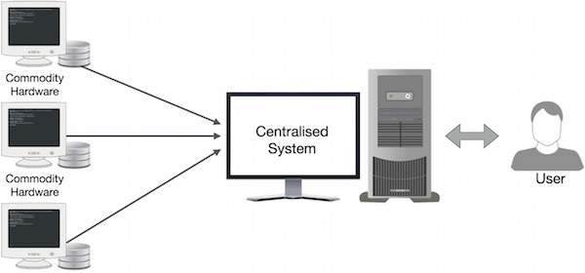
Google solved this bottleneck issue using an algorithm called mapreduce.
Mapreduce divides a task into small parts and assigns them to many computers.
Later, the results are collected at one place and integrated to form the result dataset.

Slide 5
How MapReduce Works?
The mapreduce algorithm contains two important tasks, namely map and reduce.
The map task takes a set of data and converts it into another set of data, where individual elements are broken down into tuples (key-value pairs).
The reduce task takes the output from the map as an input and combines those data tuples (key-value pairs) into a smaller set of tuples.
The reduce task is always performed after the map job.
Let us now take a close look at each of the phases and try to understand their significance.

Slide 6
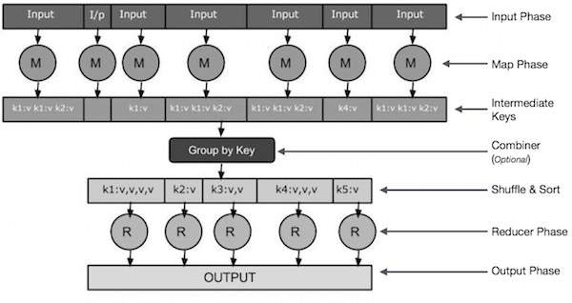

Slide 7
Architecture
Mapreduce and HDFS are the two major components of hadoop which makes it so powerful and efficient to use.
Mapreduce is a programming model used for efficient processing in parallel over large data-sets in a distributed manner.
The data is first split and then combined to produce the final result.
The libraries for mapreduce is written in so many programming languages with various different-different optimizations.
The purpose of mapreduce in hadoop is to map each of the jobs and then it will reduce it to equivalent tasks for providing less overhead over the cluster network and to reduce the processing power.
The mapreduce task is mainly divided into two phases map phase and reduce phase.

Slide 8
Phases
Map Phase
As the name suggests its main use is to map the input data in key-value pairs. The input to the map may be a key-value pair where the key can be the id of some kind of address and value is the actual value that it keeps. The Map() function will be executed in its memory repository on each of these input key-value pairs and generates the intermediate key-value pair which works as input for the Reducer or Reduce() function.
Reduce Phase
The intermediate key-value pairs that work as input for Reducer are shuffled and sort and send to the Reduce() function. Reducer aggregate or group the data based on its key-value pair as per the reducer algorithm written by the developer.

Slide 9
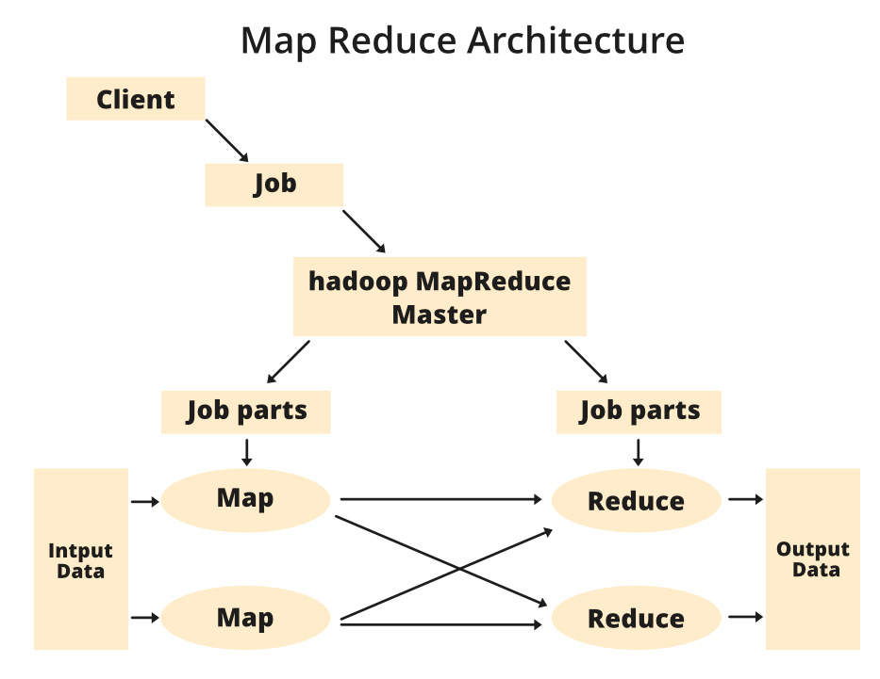

Slide 10
application
It is used in applications like distributed pattern-based searching, query processing, fraud detection and user behaviour analysis.
Moreover, the MapReduce model has been adapted to several computing environments like multi-core and many-core systems, desktop grids, as well as dynamic and mobile cloud environments.

Slide 11
Advantages 1) Mapreduce can work with minimal amount of memory and give results very fast. 2) Mapreduce save and retrieve its results on each iteration. Disadvantages 1) It is not flexible i.e. The mapreduce framework is rigid. 2) This is the only possible flow of execution.

Slide 12
Thank you

